Slide 1
Progress report
Speaker: Geng-Yun Tien
Advisor: Eric Y. Chuang
Date: 2023/10/11

Slide 2
Works
1
Use trained SimCLR model to extract feature
2
Train inception v3 and densenet121 model (patch-level prediction)
3
Big lab meeting paper presentation
Other works
1
TA works & homework

Slide 3
KRAS gene mutation patch-level prediction - Inception v3
testing | Accuracy | Sensitivity | Specificity | AUC
Results | 0.5282 | 0.5501 | 0.5056 | 0.5279
training | Accuracy | Sensitivity | Specificity | AUC
Results | 0.8798 | 0.895 | 0.8657 | 0.8803
KRAS gene mutation patch-level prediction – Densenet121
testing | Accuracy | Sensitivity | Specificity | AUC
Results | 0.5232 | 0.5778 | 0.4523 | 0.5224
training | Accuracy | Sensitivity | Specificity | AUC
Results | 0.9166 | 0.9354 | 0.8992 | 0.9173

Slide 4
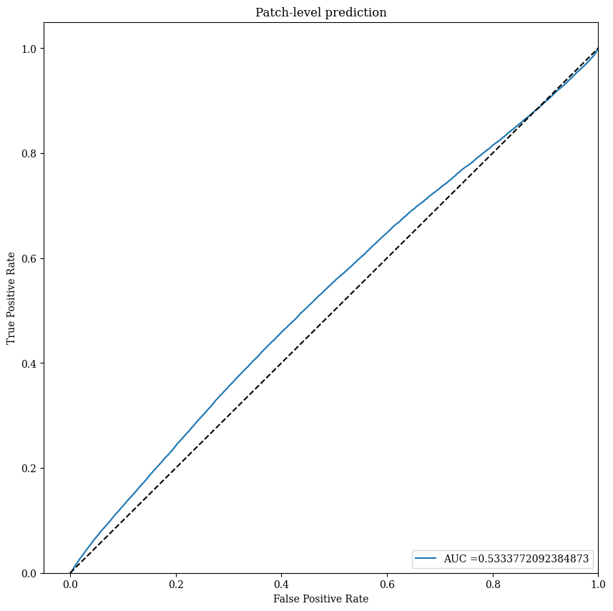
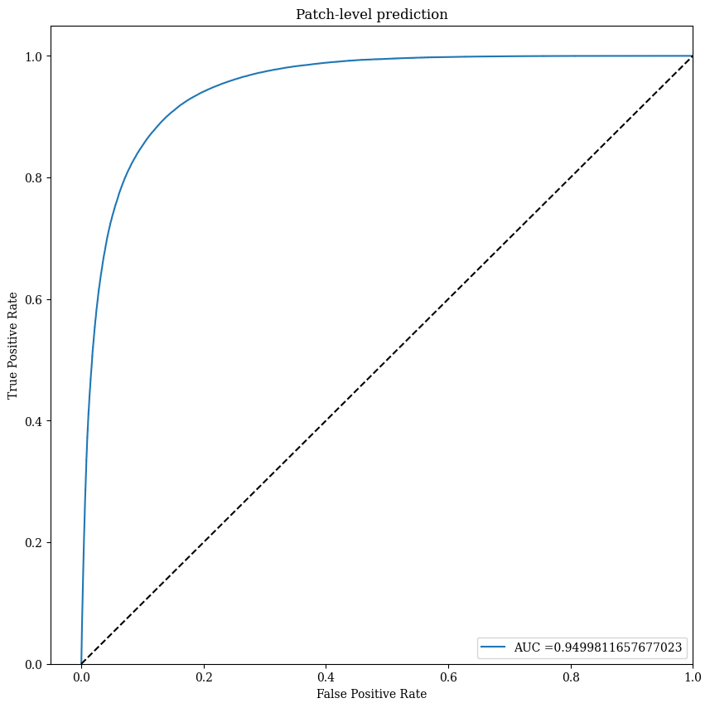
KRAS gene mutation prediction – Inception v3

Slide 5
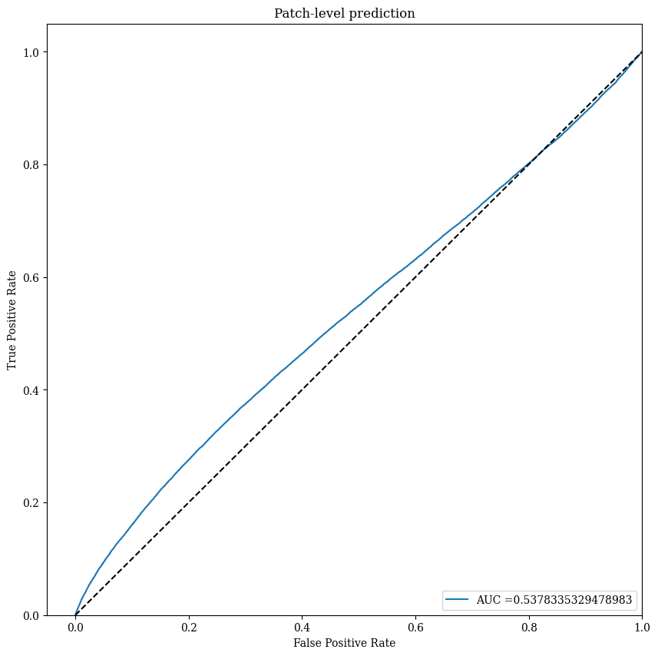
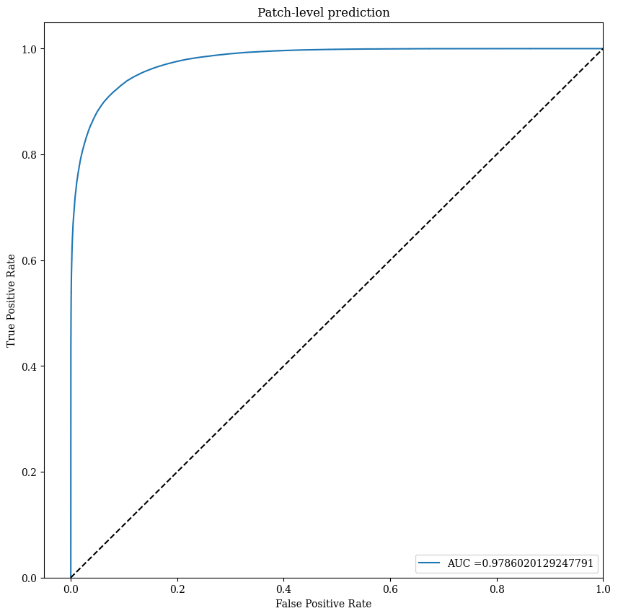
KRAS gene mutation prediction – Densenet121

Slide 6

Future work
1
Aggregate slide level prediction
2
Single task vs. multiple task training

